Slide 1
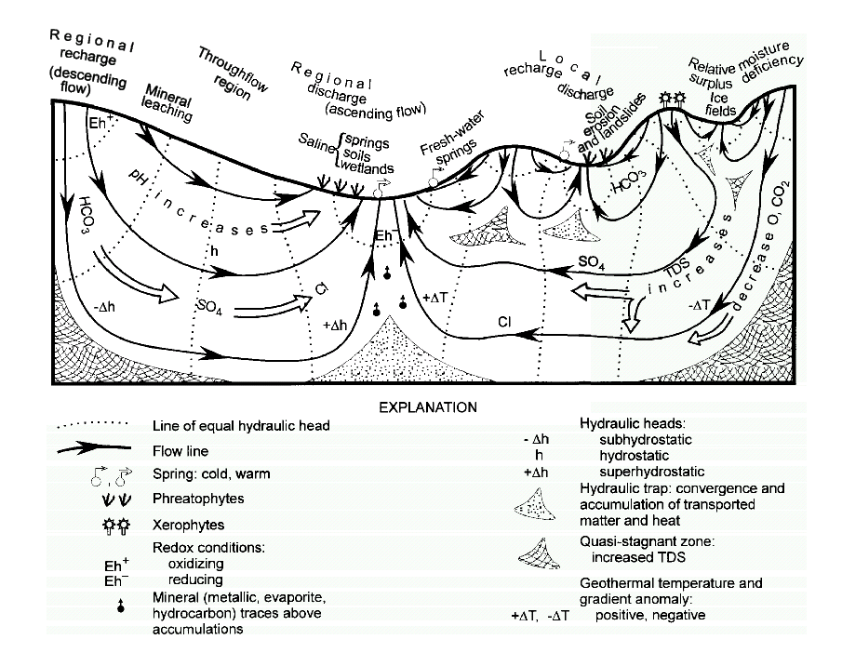
Regional Flow System: Geochemical Evolution (Tóth,2009)

Slide 2
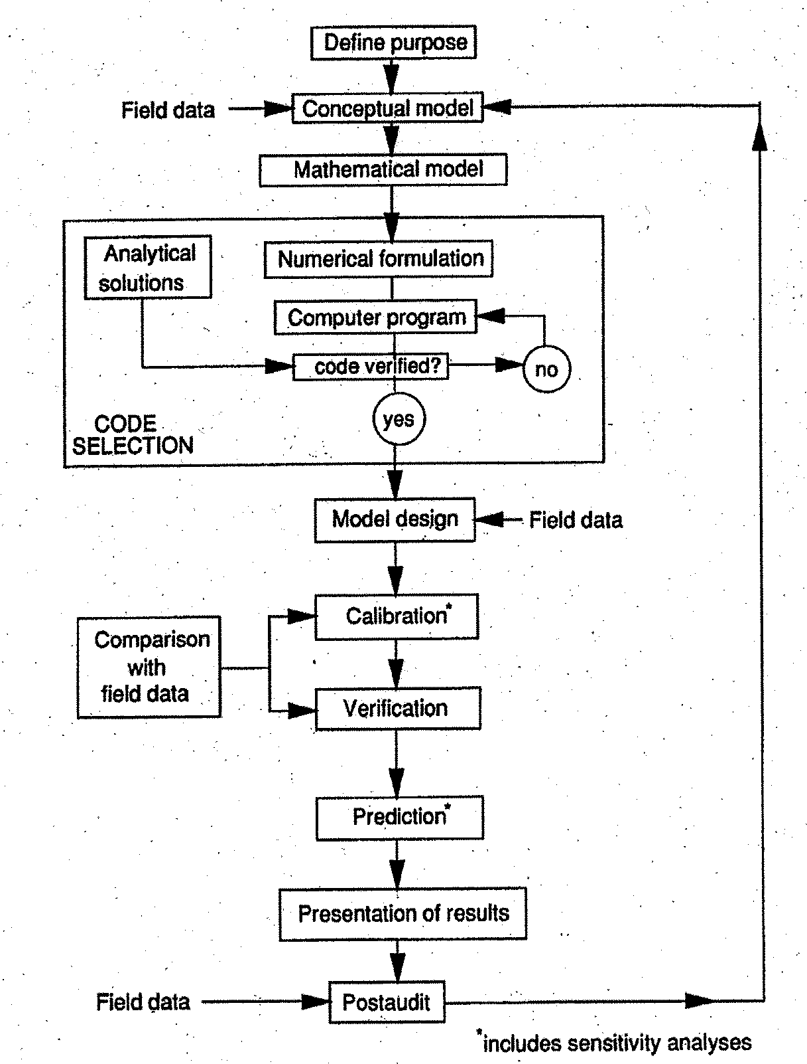

Protocol for
Model Applications

Slide 3
FLONET Model
2D vertical flow system
Hydraulic head: φ = z +P/ρg
Velocity: v = -K∇φ /θ
Recharge
Gradient h
source
Stream
Symmetry
Boundary
h
Symmetry
Boundary
v
Impermeable Bottom

Slide 4
Summary: Flow Boundary Conditions:
Type 1 or “Dirichlet ”: Fixed head h=h_{o}
h_{o}
e.g. :
h_{o}
h_{o}
´
h_{o}
Type 2 or “Neuman” : Fixed gradient K·h=q₀
q_{o}
q_{o}
q_{o}
e.g. :
q_{o}=0
q_{o}
q_{o}
q_{o}=0
q_{o}=0
q_{o}=0
q_{o}=0
q_{o}
q_{o}=0
Notes:
4

Slide 5
